Slide 1



Web3
Growth
Intelligence
& User Behavior
Analysis
Powered by multi-source analytics: identity, on-chain data, behavioral signals, and lifecycle modeling.
Dashboard : https://web3statergia.streamlit.app/

Slide 2

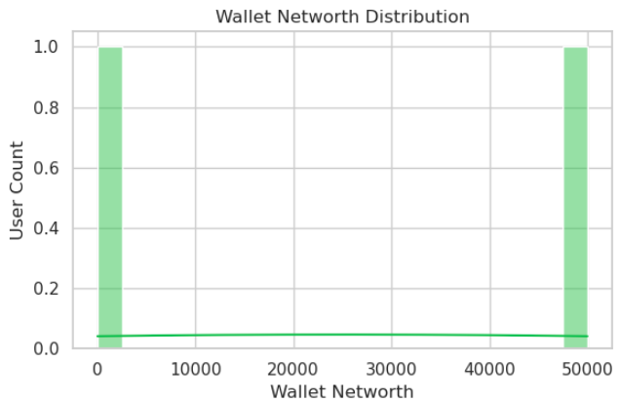
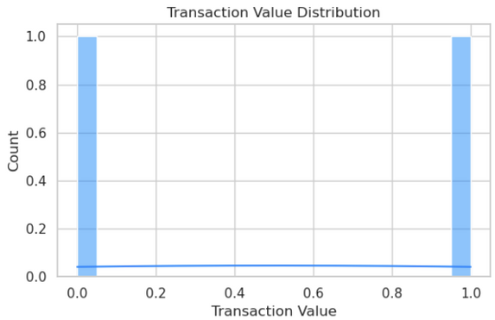


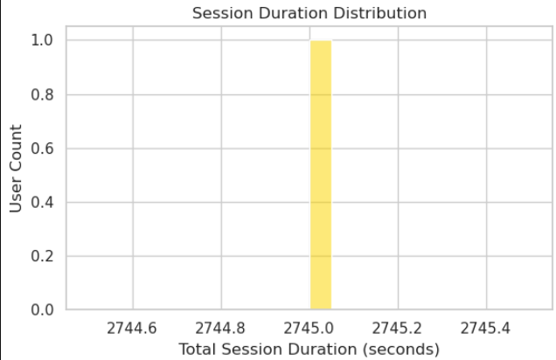
Why
User Analytics Matters
Key Insights
Web3 wallet holders demonstrate deeper sessions and stronger value potential.
Transaction timing clusters indicate episodic but high-intent engagement.
Early patterns reveal strong correlation between session depth and eventual monetary contribution.
Behavioral data acts as a predictive signal for retention and upsell readiness.
Understanding user behavior is the foundation of Web3 growth.
Our analysis connects engagement, wallet activity, and session patterns to uncover meaningful trends.
Key

Slide 3
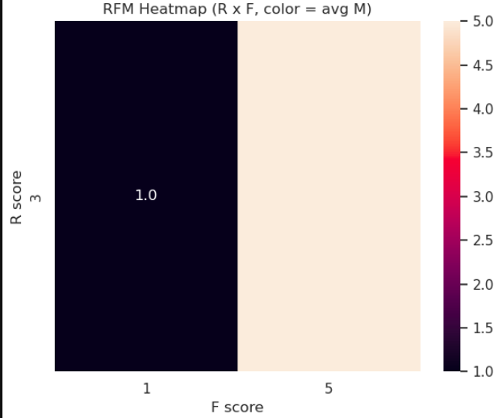
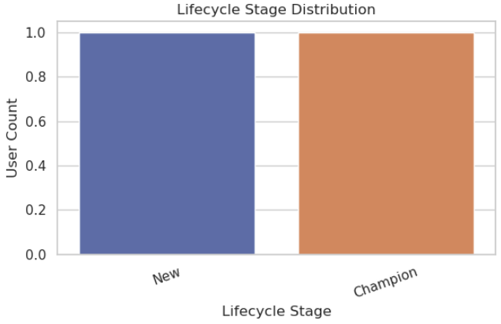
Lifecycle & RFM Segmentation
Segments Identified
Champions – Highly engaged, highest value contributors.
Loyal Users – Stable repeat activity with predictable patterns.
Potential Users – Growing engagement; strong upsell candidates.
New Users – Require onboarding and structured activation.
At-Risk Users – Showing signals of disengagement or drop-off.
Why it matters
This framework supports targeted messaging, retention programs, and personalized lifecycle journeys.

Slide 4
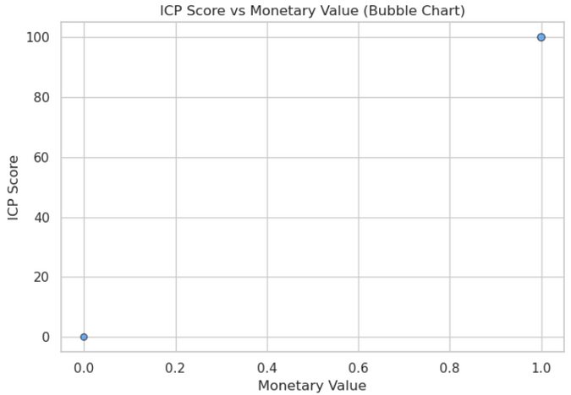
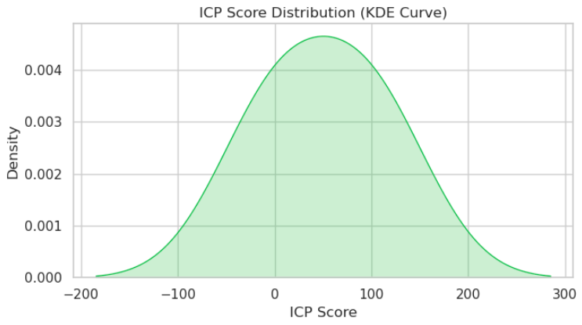
ICP (Ideal Customer Profile) Modeling
ICP modeling identifies traits of high-value Web3 users across behavior, wallet strength, and interaction depth.
Core Signals Used
Wallet networth & on-chain activity
Session count & engagement depth
RFM segmentation indicators
Conversion-related behaviors
What we discovered
High-ICP users cluster tightly around strong monetary and engagement signals.
ICP scoring differentiates premium segments for targeted acquisition.
This enables smarter budget allocation across channels and creative.

Slide 5

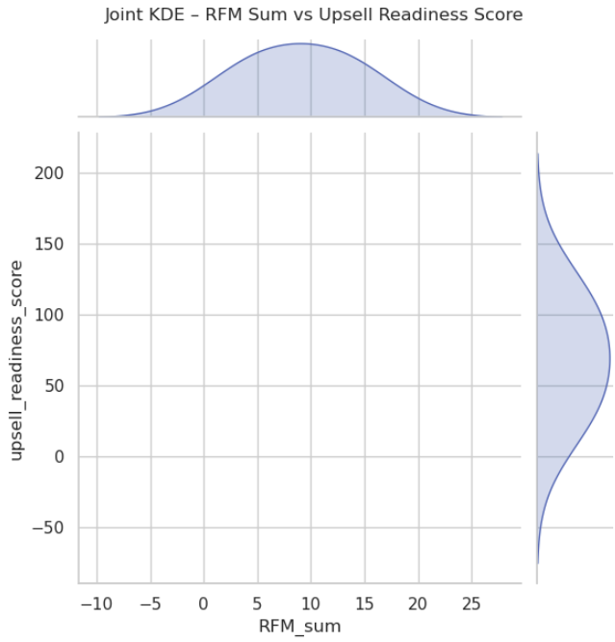
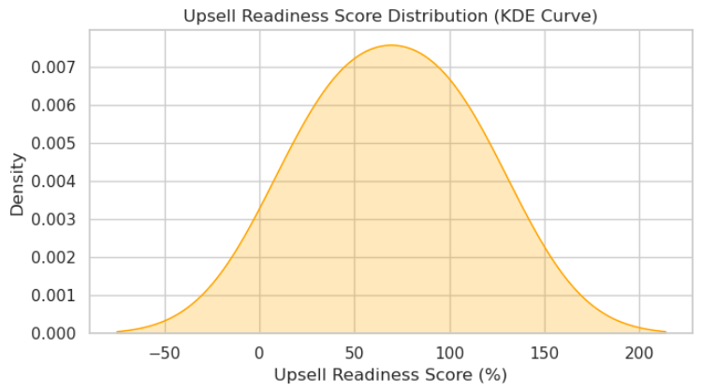
Upsell Readiness Model
A predictive classifier estimates the likelihood of each user becoming a Champion or Loyal in upcoming cycles.
Model Signals
R, F, M scores
Total RFM sum
Engagement metrics
Outcome
Identifies which users are ready for higher-tier features.
Helps prioritize premium messaging and targeted nudges.
Enables measurable uplift strategies.

Slide 6
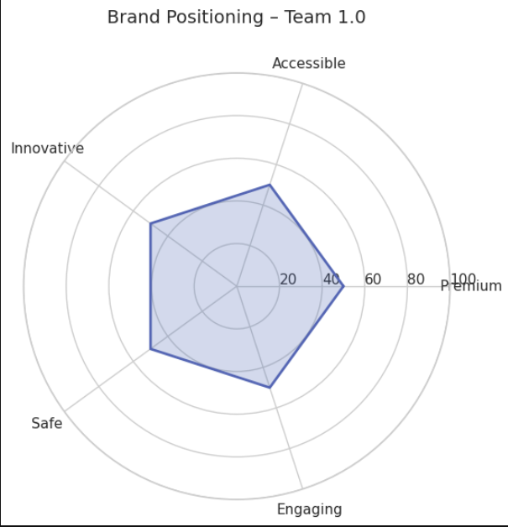
Brand Positioning Analysis
Brand perception is mapped across five strategic axes:
Dimensions Measured
Premium
Accessible
Innovative
Safe
Engaging
Key Findings
Strong positioning on Innovative and Accessible.
Moderate perception of Safety and Engagement, suggesting areas to reinforce.
Provides direction for future content, UX improvements, and messaging.
www.reallygreatsite.com

Slide 7
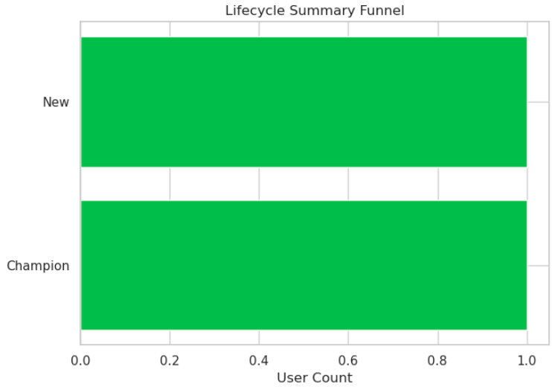
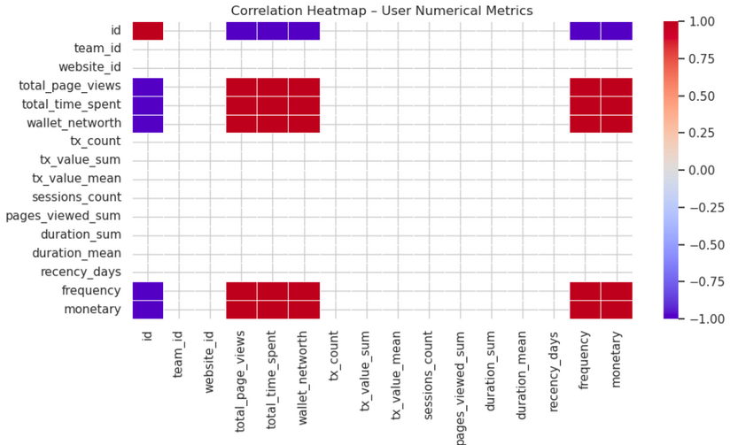
Conclusion & Strategic Recommendations
What the data tells us
A clear pathway exists for identifying and nurturing high-value users.
Lifecycle segmentation reveals where to apply retention & growth efforts.
ICP modeling sharpens acquisition strategy.
Upsell scoring enables targeted premium journeys.
Brand perception highlights communication opportunities.
Next Steps
Expand high-ICP user acquisition.
Strengthen onboarding & activation for “Potential” and “New” users.
Build re-engagement workflows for “At-Risk” users.
Reinforce brand pillars through UX, education, and trust elements.
Deploy a real-time dashboard for ongoing insight tracking.

